Slide 1
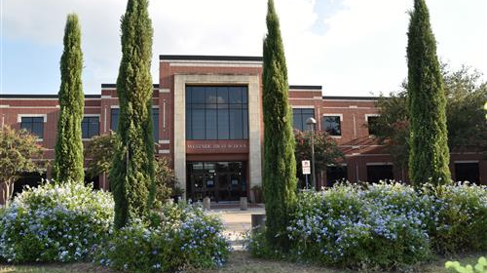
Westside High School Parent Teacher Organization presents
Together We Can Do… Virtually Anything
PTO Speaker Series and General PTO Meeting 2020-21
Remember:
When joining, please silence your video and audio feature

Slide 2
Outcomes for Today
Elect 2021-22 Executive Board
Committee Leadership
Connect with principal and community

Slide 3
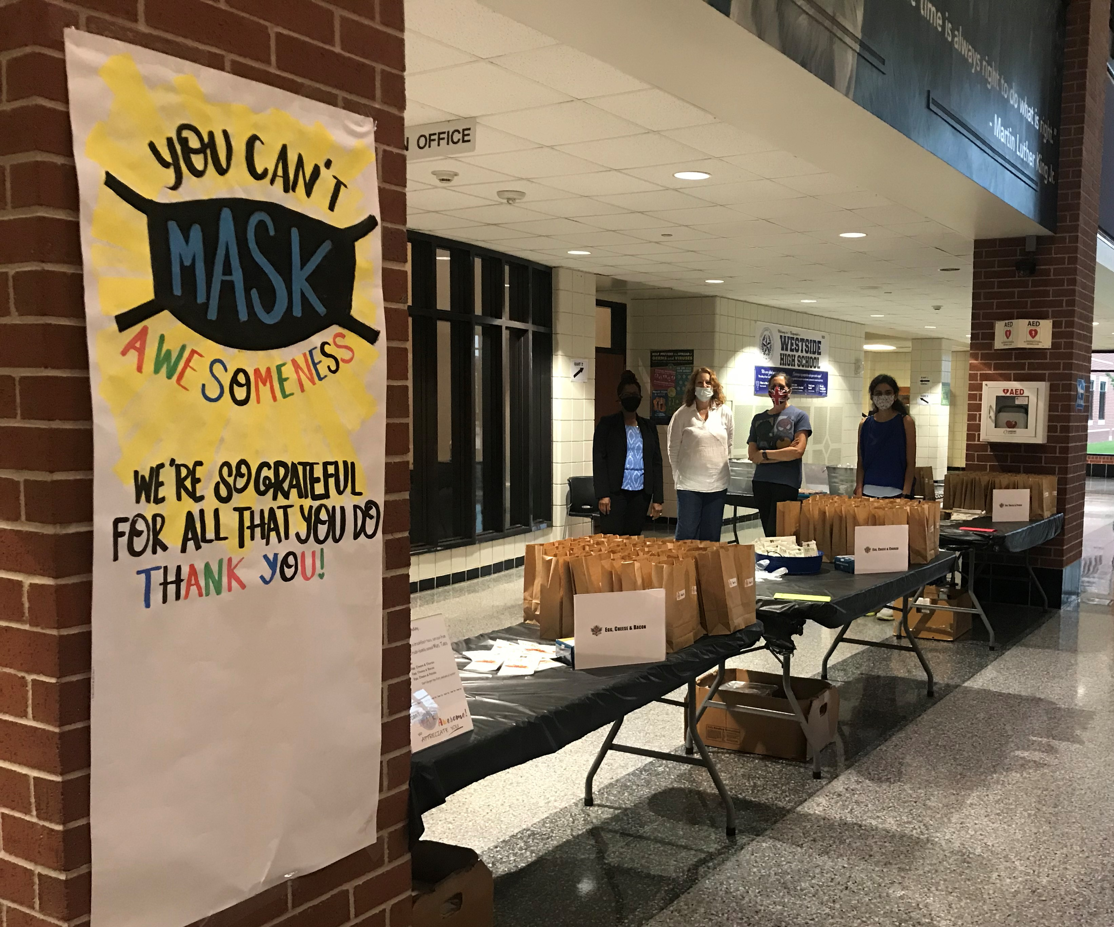
Volunteer Appreciation
Special thanks to our Staff Appreciation volunteers:
Toni Wittrock, Leslie Evans, Laura McDuffie, Shipra Jhunjhunwala, Stephanie Brewster, Anni Krisanto, Sonia Garces, Martha Jacob, Carlos Villagrana, and Mary Edrich

Slide 4
2021-22 Executive Board
Principal - Keri Wittpenn
President - Sarah Castro, 9 & 12
1st VP Membership - Anni Krisanto, 9 & 12
VP Fundraising - Sonia Garces, 12
Treasurer - Cossette Hurtado, 12
Recording Secretary - Stephanie Brewster, 10
Corresponding Sec’y- Gypsy Morinelli, 9 & 12
VIPS Coordinator - Leslie Evans, 10
Parliamentarian - George Oggero, 10
Exec. Board Faculty - Suspa Sinha Chowdhury
2-year terms
Meetings – August, September, October, November, February, April, May
Minutes posted on website

Slide 5
2021-22 Committees
Welcome & Recruiting - Back-School Bash, Open House, Westside Showcase
First Day Packets - See Carrie Frain
Homecoming - Parade, House Decorations
Homecoming Dance - Dance prep, chaperoning, etc.
Staff Appreciation - Events in August, November, December, April, June
Spring Fundraiser/Social - Assist VP of fundraising
Senior Class - See Leslie Dockins and Erin Fisk
Alumni Association - Assist with alumni breakfast & scholarship fundraising
College Center - Assist with College Night
Landscaping - Westside Beautification

Slide 6
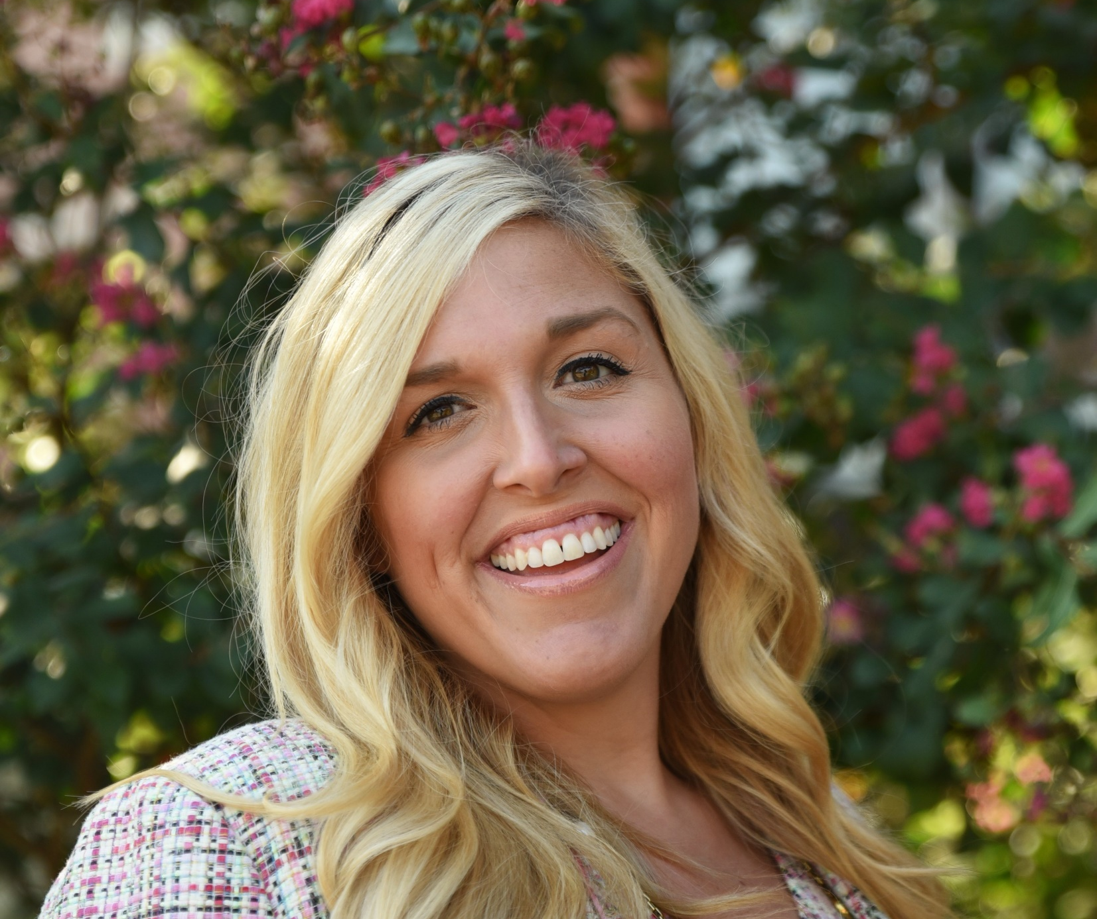
Keri Wittpenn
Westside High School Principal

Slide 7
Why Westside?
Why did you and your family choose Westside High School?
Flipgrid Feedback
https://flipgrid.com/bd704463

Slide 8
Senior Week
Monday 6/7 |  | Tuesday 6/8
Final Exams 3rd & 7th Periods |  | Final Exams 6th Period
Wednesday 6/9 |  | Thursday 6/10
Senior Check-Out Various Timeslots / Auxiliary (“Lego”) Gym To pick-up their cap & gown, students will report to Westside in alphabetic groups at the designated times below. Students will first need to complete an electronic form – the College Center will share a link to that document soon.
Wed. 9 AM-12 PM Last Names S-Z | Wed. 1-4 PM Last Names M-R | Thu. 9 AM-12 PM Last Names E-L | Thu. 1-4 PM Last Names A-D
Friday 6/11 |  | Sunday 6/13
Graduation Practice 9-11 AM / Commons |  | Graduation 5 PM / Delmar Field The Class of 2021 will walk across stage in this outdoor ceremony! See below for more details.
Senior Picnic 12:00-2:30 PM / Athletic Fields The PTO is celebrating our grads with food, music, and outdoor games.
Senior Honors will be virtual again this year. Winners of academic, athletic, and character awards will be revealed via WHS social media accounts in the evenings throughout Senior Week. Follow the awards online: #2021wolfpackhonors

Slide 9
We Want YOU…
To JOIN the Westside PTO for 2021-22

Slide 10
Show your Westside Spirit Buy a Westside Wolves Yard Sign!
POST A PHOTO WITH YOUR STUDENT AND THEIR YARD SIGN ON FACEBOOK OR INSTAGRAM
RAISE MONEY FOR THE PTO
REUSE SIGN YEAR AFTER YEAR
SHOW YOUR SCHOOL SPIRIT!
$15
ORDER ONLINE TODAY!
ORDER YOUR SIGN ONLINE AT: https://www.westsidehighpto.org/shop-1
SPONSORED BY WESTSIDE HIGH SCHOOL PTO

